Slide 1
CS30500: Introduction to Software Engineering
Spring 2025
Lecture #14
Prof. In-Young Ko
School of Computing

Slide 2
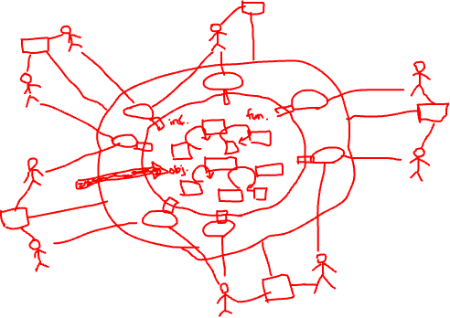
Last Class
Requirements Models
Scenario-based modeling
Class-based modeling
Behavioral modeling
Domain modeling
Traceability

Slide 3
Today’s Plan
Design Concepts
Modularization
Information hiding
Cohesion
Coupling

Slide 4
Design Concepts

Slide 5
“Computer Programming is a Dying Art”
(Source: Newsweek, by Kevin Maney, 2014)
“There is definitely a need for people to learn kind of a computer science way of thinking about problems, but not necessarily the language du jour,” says Erik Brynjolfsson, a professor at the MIT Sloan School of Management
Irving Wladawsky-Berger, formerly of IBM and now at New York University, “We should definitely teach design. This is not coding, or even programming. It requires the ability to think about the problem, organize the approach, know how to use design tools.”
Adopted from Prof. Doo-Hwan Bae’s CS350 lecture material

Slide 6

“Don’t Learn to Code”
Nvidia's founder Jensen Huang
@World Government Summit 2024 in Dubai
https://www.youtube.com/watch?v=yj73GIEKmLI

Slide 7
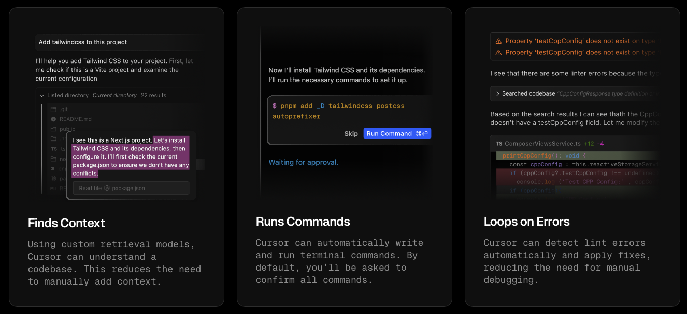
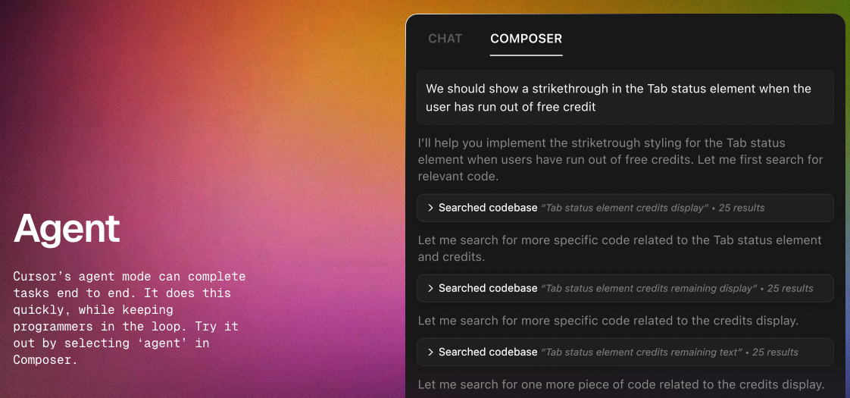
Coding with AI
https://www.cursor.com/features
https://www.youtube.com/watch?v=LR04bU_yV5k

Slide 8
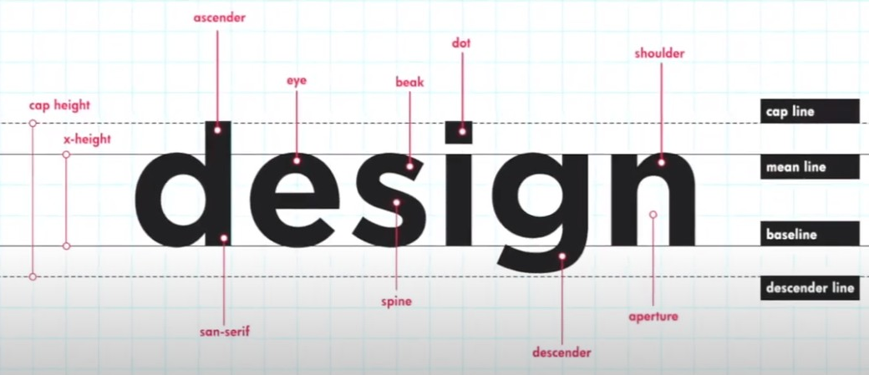
What is software design?
The last SE action within the modeling activity and sets the stage for construction (code generation and testing)
Transforms requirements into the form that can help developers to build a software system effectively
https://www.rmit.edu.vn/study-at-rmit/undergraduate-programs/bachelor-design-studies
Data/Class design – transforms analysis classes into implementation classes and data structures
Architectural design – defines relationships among the major software structural elements
Interface design – defines how software elements, hardware elements, and end-users communicate
Component-level design – transforms structural elements into procedural descriptions of software components
[PrMa20 ]

Slide 9
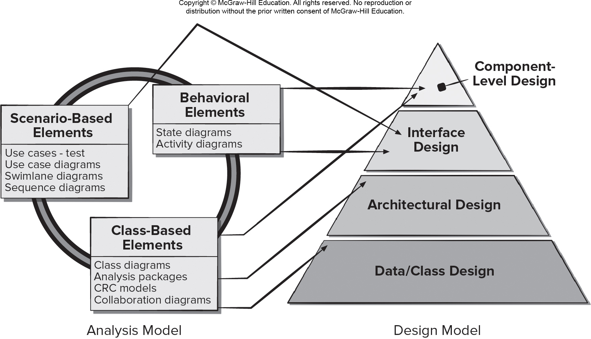
Mapping Requirements Model to Design Model
[PrMa20 ]

Slide 10
Why is design important?
The first step to propose a solution for the problem under development
What is importance of software design?
Design is the place where _____ is fostered.
Design provides us with representations of software that can be assessed for _____ .
Adopted from Prof. Doo-Hwan Bae’s CS350 lecture material
Notes:
위의 정답은 “품질”
품질은 개발이 완료된 후의 시험을 통해 만들어지는 것이 아니라, 요구 사항 분석 단계에서 품질에 대한 목표가 결정되면, 이러한 품질에 대한 목표를 달성하기 위하여 설계에서부터 반영하여야 한다.

Slide 11
Design and Quality
The design must implement all of the explicit requirements contained in the analysis model, and it must accommodate all of the implicit requirements desired by the customer
The design should be a readable, understandable guide for those who generate code and for those who test and subsequently support the software
The design should provide a complete picture of the software, addressing the data, functional, and behavioral domains from an implementation perspective
[PrMa20 ]
https://www.designcommunication.net/design/lemon-squeezer-same-function-different-products

Slide 12
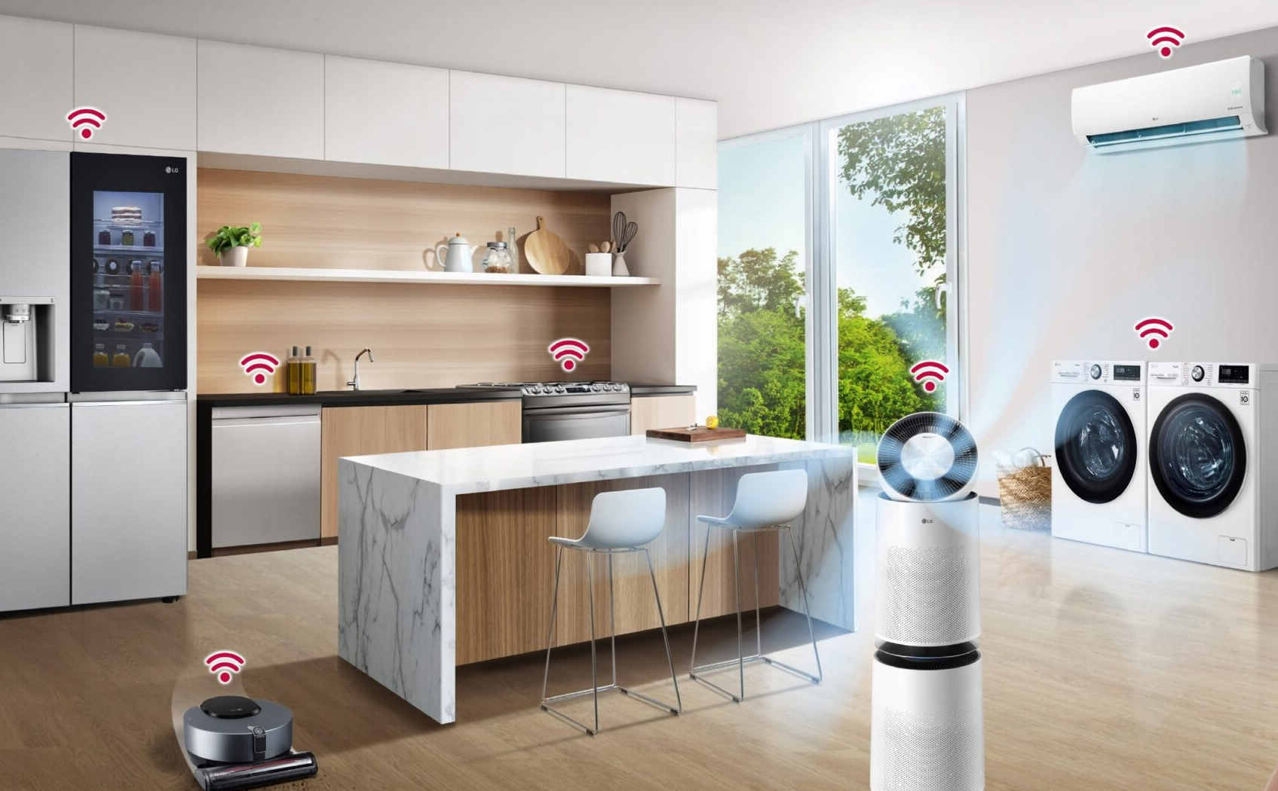


As a Software Engineer…
Your task is to design and develop a smart home system where a butler robot understands the user's needs and seamlessly controls and coordinates home appliances.
Architectural design of the smart home system featuring the AI butler robot
[Generated by ChatGPT 4o]

Slide 13
Design Concepts (1/2)
Abstraction
Data – named collection of data describing data object
Procedural – named sequence of instructions with specific and limited function
Architecture
Overall structure or organization of software components
Ways components interact
Structure of data used by components
Design Patterns
Describe a design structure that solves a well-defined design problem within a specific context
Separation of Concerns
Any complex problem can be more easily handled if it is subdivided into pieces
Modularity
Compartmentalization of data and function
[PrMa20 ]

Slide 14
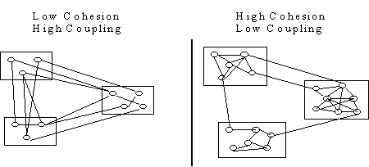
Design Concepts (2/2)
Information Hiding
Controlled interfaces which define and enforces access to component procedural detail and any local data structure
Functional Independence
Single-minded (high cohesion) components with aversion to excessive interaction with other components (low coupling)
Stepwise Refinement
Incremental elaboration of detail for all abstractions
Refactoring
A reorganization technique that simplifies the design without changing functionality
Design Classes
Provide design detail that will enable analysis classes to be implemented
[PrMa20 ]

Slide 15
Modularization

Slide 16

Modularization
Modularization is a technique to divide a software system into multiple discrete and independent modules, which are expected to be capable of carrying out task(s) independently
Modules may work as basic constructs for the entire software
Modules can be executed and/or compiled separately and independently
https://www.linkedin.com/pulse/how-innovations-modularization-driving-construction-tannis/
https://www.tutorialspoint.com/software_engineering/software_design_basics.htm
Adopted from Prof. Doo-Hwan Bae’s CS350 lecture material
Notes:
Top down : http://elearning.algonquincollege.com/coursemat/pincka/dat2219d/lectures/27-Modules.htm
Determining an employee's pay based on hours worked and pay rate (and using some company standard values for overtime). Notice that, in these examples, modules (elements which require further expansion) have been numbered for reference purposes.
Employee_Pay
[Get_Employee_Pay_Values]
[Calculate_Net_Pay] DISPLAY netPay
END1. Get_Employee_Pay_Values
Get_Hours_Worked
Get_Rate_of_Pay
RETURN2. Calculate_Net_Pay
[Calculate_Gross_Pay]
[Calculate_Total_Deductions] netPay = grossPay - deductions
RETURN2.1 Calculate_Gross_Pay
[Calculate Regular Pay]
[Calculate Overtime Pay] grossPay = regularPay + overtimePay
RETURN2.2 Calculate_Total_Deductions
[Calculate Income Tax Deduction]
[Calculate Canada Pension Plan Deduction]
[Calculate Union Dues Deduction]
[Calculate Health Insurance Deduction] ADD all deductions to get totalDeductions
RETURN
Example 3: Determine the total payroll (total of net pay) for all employees of some company. (Having solved a simple problem before, we can use the components of this simpler problem to solve this more complex one).
Determine_Payroll
set totalPayroll to zero
[Get_Employee_Pay_Values] (first) WHILE not EOF
[Process_One_Employee] ENDWHILE DISPLAY totalPayroll
END
3. Process_One_Employee
[Calculate_Net_Pay] ADD netPay to totalPayroll
[Get_Employee_Pay_Values] (next)
RETURN
Since the two sub-modules within this solution algorithm have already been developed, there is no need to repeat this analysis (although the module numbering would change).

Slide 17
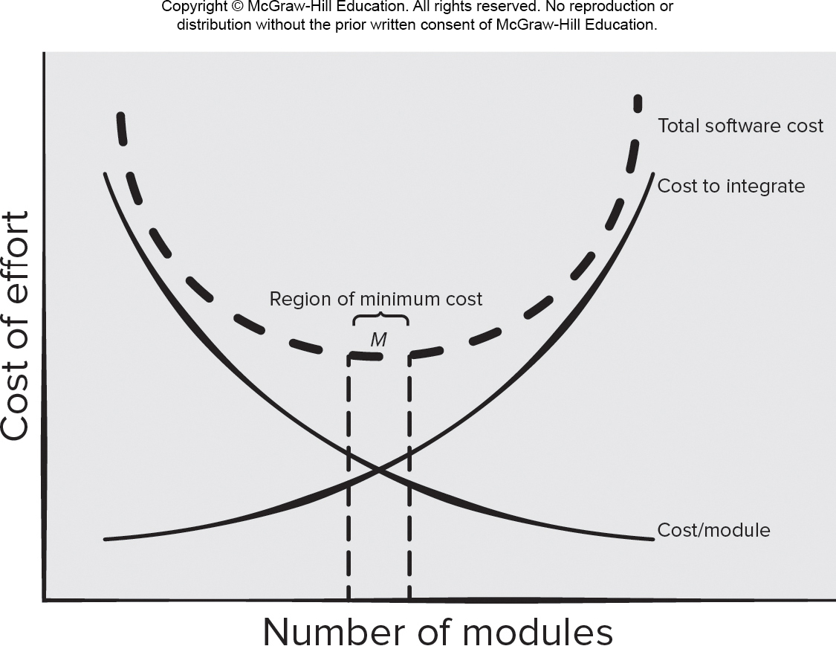
Modularity and Software Cost
[PrMa20 ]

Slide 18
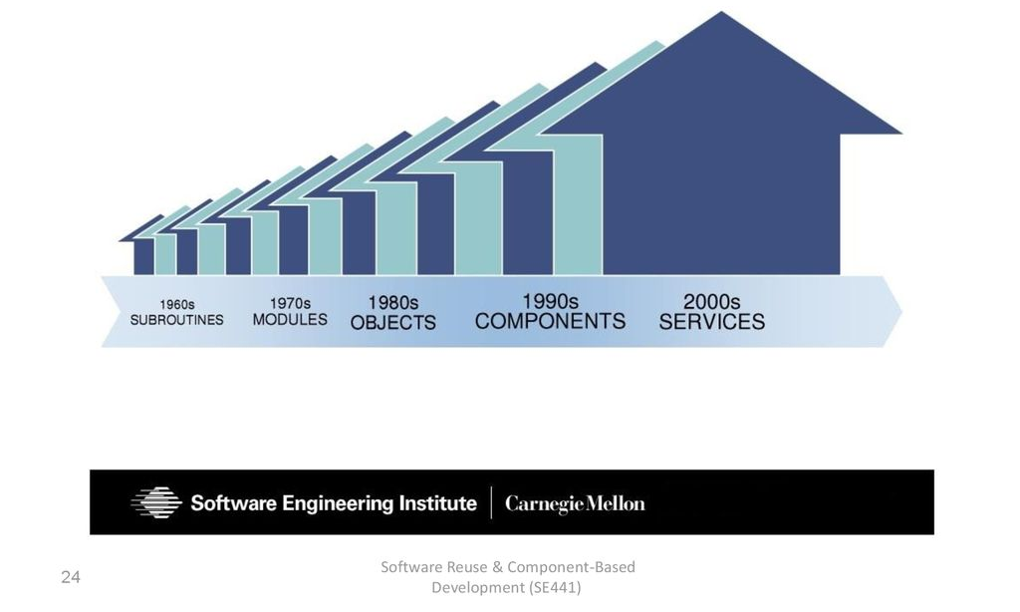
Software Reuse History

Slide 19
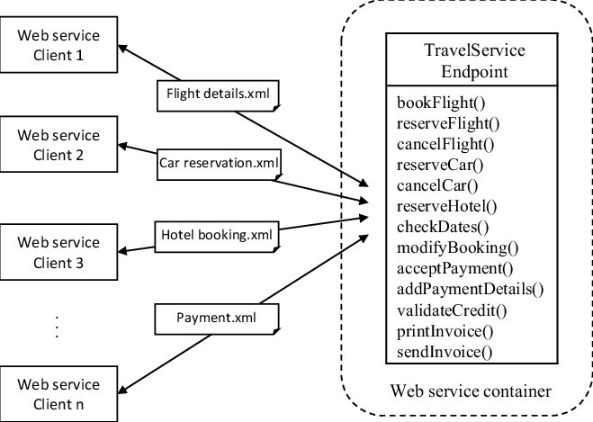
Practical Guide to Modular Design
Adopted from Prof. Doo-Hwan Bae’s CS350 lecture material
Purpose: should have a single responsibility
Interface: easy to use, understand, and ensure correctness
Information hiding: expose as little as possible
Dependency: minimize dependencies between modules
Avoid followings:
Circular dependencies
Not testing in isolation
Too many small modules
Having modules changing together frequently
Unstable interface
Unhealthy inheritance hierarchy
God module (class)
Duplicated functionality
A God Module
https://www.researchgate.net/figure/An-example-of-god-object-Web-service_fig1_307572331

Slide 20
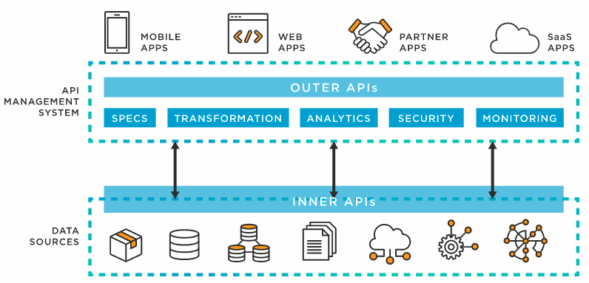
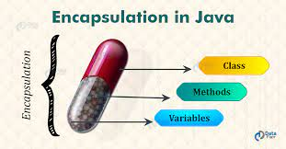
Encapsulation vs. Information Hiding
Encapsulation means drawing a boundary around something
It means being able to talk about the inside and the outside of it
Object-oriented languages provide a way to do this
Encapsulation is a programming language feature
Information hiding is the idea that a design decision should be hidden from the rest of the system to prevent unintended coupling
Information hiding is a design principle
https://www.tibco.com/reference-center/what-is-an-api
(source: C2 wiki)
https://data-flair.training/blogs/encapsulation-in-java/
Adopted from Prof. Doo-Hwan Bae’s CS350 lecture material
Notes:
Encapsulation: Contact 600 Cold medicine: distinguish contents from the outside through a capsule
Information hiding: implementation details are not known to outside

Slide 21
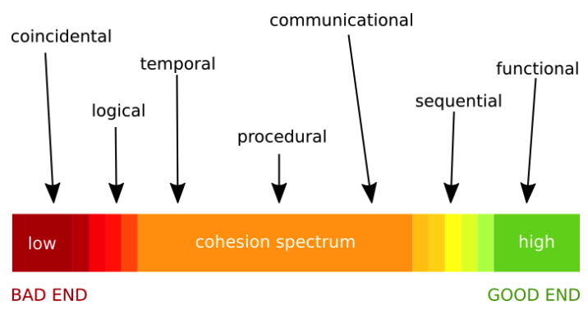
Cohesion
The measure of strength of the association of elements within a module
Highly cohesive modules are desired
Levels of cohesion:
https://rajasegar.medium.com/do-you-care-about-cohesion-in-javascript-functions-8b1dc26e1ca0
David Stotts, Intramodule Cohesion, COMP145, University of North Carolina (https://www.cs.unc.edu/~stotts/COMP145/cohesion.html)
Adopted from Prof. Doo-Hwan Bae’s CS350 lecture material

Slide 22
Coincidental Cohesion
The elements in a module are not related but simply bundled together
Where does this type of cohesion come from?
Sloppy maintenance
Subroutinization
... Subroutine P
... A;
s: A; B;
B; C;
C; End P;
... ...
... s: P
t: A; ...
B; ...
C; ...
... t: P
... ...
... ...
David Stotts, Intramodule Cohesion, COMP145, University of North Carolina (https://www.cs.unc.edu/~stotts/COMP145/cohesion.html)
Adopted from Prof. Doo-Hwan Bae’s CS350 lecture material

Slide 23
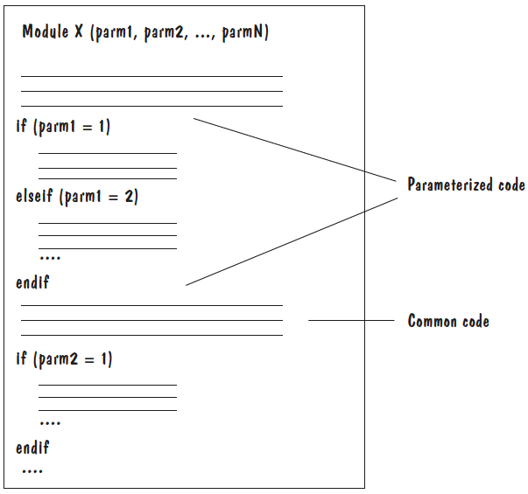
Logical & Temporal Cohesion
Logical Cohesion
The elements in a module perform similar or related functions that fall into the same logical class
Examples:
Generalized transaction processing
General error handling
Temporal Cohesion
All the elements in the module are activated at a single time
Examples:
Initialization
Termination
Pfleeger, Shari Lawrence and Lawrence Pfleeger. “Software Engineering: Theory and Practice”
Adopted from Prof. Doo-Hwan Bae’s CS350 lecture material
David Stotts, Intramodule Cohesion, COMP145, University of North Carolina (https://www.cs.unc.edu/~stotts/COMP145/cohesion.html)

Slide 24
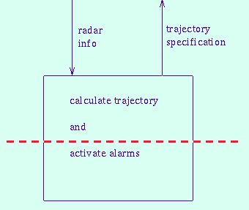
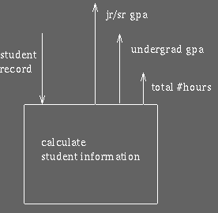
Procedural & Communicational Cohesion
Procedural Cohesion
The elements in a module are involved in different activities, but are invoked as a sequence
Examples:
Calculate trajectory and activate alarms
Read Part_Number from DB and Update Repair_Record on Maintenance_File
Communicational Cohesion
All of the elements in a module operates on the same input or produce the same output
Examples:
Calculate student information
Update record in DB and write it to audit file
David Stotts, Intramodule Cohesion, COMP145, University of North Carolina (https://www.cs.unc.edu/~stotts/COMP145/cohesion.html)
Adopted from Prof. Doo-Hwan Bae’s CS350 lecture material
Notes:
In Sequential cohesion, the sequential flow is of the data flowing from one component to another component in the same module. e.g- data flowing from output of one component into input of another component of the same module.
https://stackoverflow.com/questions/41743472/what-is-difference-between-procedural-cohesion-and-sequential-cohesion-in-softwa

Slide 25
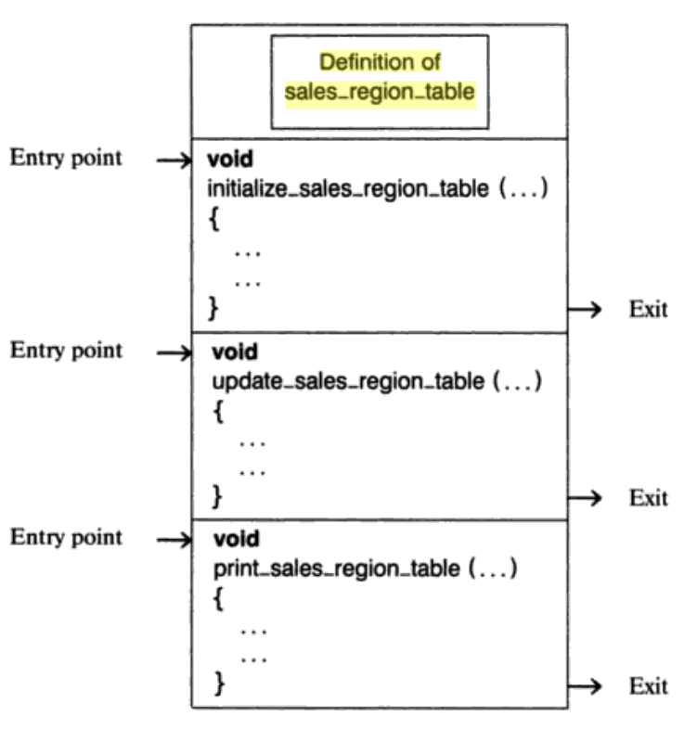
Informational Cohesion
A module performs a number of actions, each with its own entry point, with independent code for each action, all performed on the same data structure
Essentially an implementation of an abstract data type
Example: Class in OO
https://wiki.c2.com/?CouplingAndCohesion
Stephen R. Schach, “Practical Software Engineering”, Richard D Irwin
Adopted from Prof. Doo-Hwan Bae’s CS350 lecture material

Slide 26
Functional Cohesion
A module performs exactly one action or achieves a single goal
Improve reusability
Easy to maintain
Easy to extend
Examples:
Get temperature of furnace
Compute orbital of electron
Calculate sales commission
Adopted from Prof. Doo-Hwan Bae’s CS350 lecture material

Slide 27
Cohesion Exercise
Identify the type of cohesion in the following statements:
Compute average daily temperatures at various sites
Initialize sums and open files
Create new temperature record
Store temperature record
Close files and print average temperatures
Compute average daily temperatures at various sites
Initialize sums and open files
Create new temperature record
Store temperature record
Close files and print average temperature
Read in site, time, and temperature
Store record for specific site
Edit site, time, or temperature field
Adopted from Prof. Doo-Hwan Bae’s CS350 lecture material

Slide 28
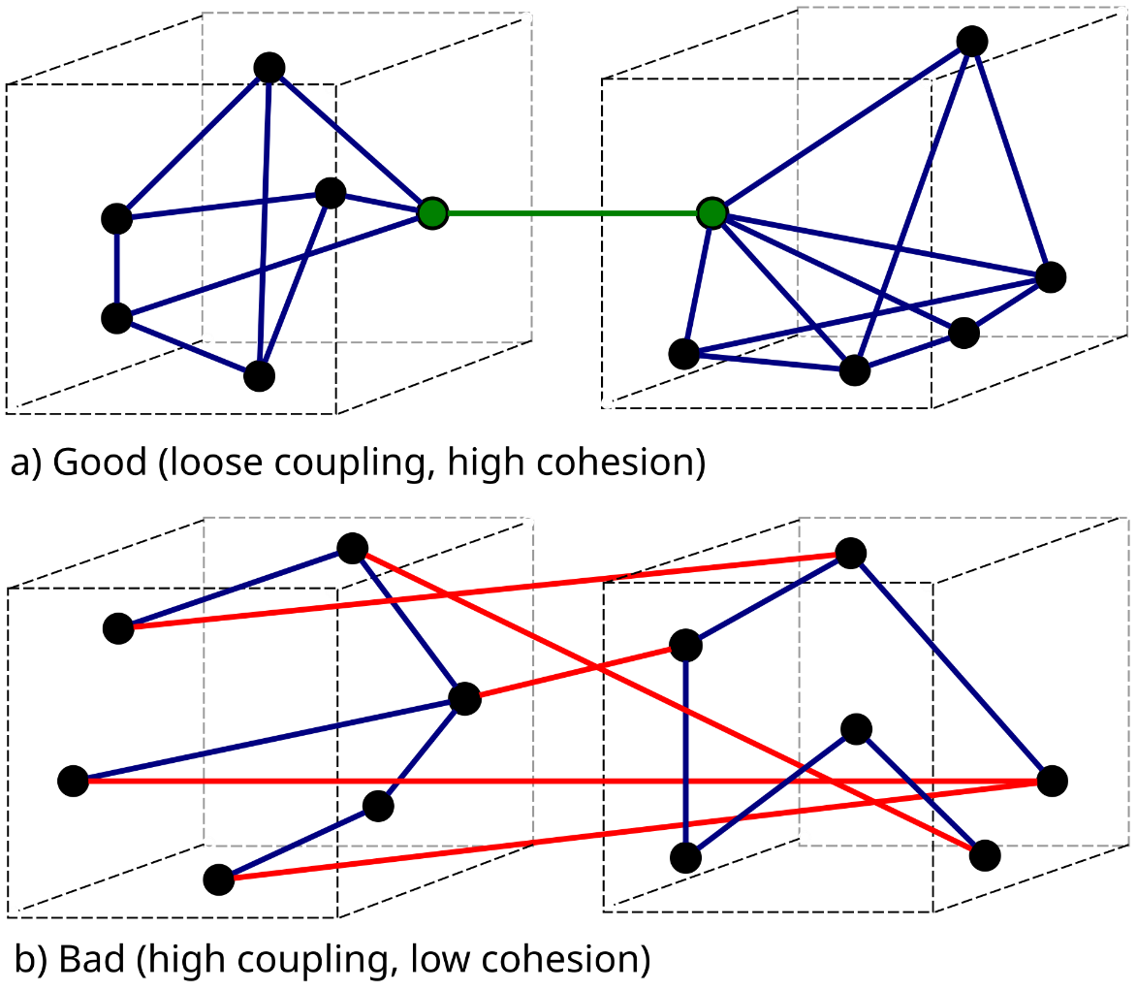
Coupling
Adopted from Prof. Doo-Hwan Bae’s CS350 lecture material
The measure of the interdependence of one module to another
Low coupling minimize ripple effect
https://en.wikipedia.org/wiki/Coupling_%28computer_programming%29

Slide 29
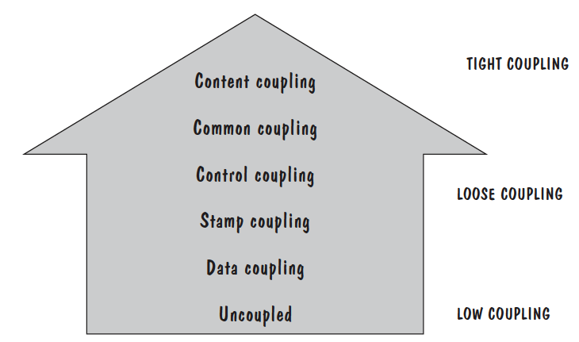
Levels of Coupling
better quality
Stephen R. Schach, “Practical Software Engineering”, Richard D Irwin
David Stotts, Intramodule Coupling, COMP145, University of North Carolina (https://www.cs.unc.edu/~stotts/COMP145/cohesion.html)

Slide 30
Content Coupling
One module branches into another module
One module references or alters data contained inside another module
Examples:
Module P modifies a statement of module Q
Module P refers to local data of module Q
Module P branches to a local label of Module Q
David Stotts, Intramodule Coupling, COMP145, University of North Carolina (https://www.cs.unc.edu/~stotts/COMP145/cohesion.html)
Adopted from Prof. Doo-Hwan Bae’s CS350 lecture material

Slide 31
Common Coupling
Two modules share the same global variables (data)
Example: ‘common’ in Fortran
Drawbacks:
Reduce readability
Can introduce side effects
Difficult to maintain
Difficult to reuse
May cause security problems
WHILE (global_variable == 0)
{
if(parameter_xyz > 25)
function_3( );
else
function_4( );
}
Adopted from Prof. Doo-Hwan Bae’s CS350 lecture material

Slide 32
Control Coupling
Two modules communicate through control flags
One module explicitly controls the logic of the other
Q: control-coupled?
Module P calls module Q, and passes back a flag to P that says, "I am unable to complete my task.", then Q is passing data.
If the flag means, "I am unable to complete my task; accordingly, write error message ABC123."
Drawbacks:
Two modules are not independent
Generally associated with logical cohesion
⬅ control coupled
Adopted from Prof. Doo-Hwan Bae’s CS350 lecture material

Slide 33
Stamp Coupling
Two modules communicate via a passed data structure which contains more information than necessary
Example:
Calculate_withholding(employee_record)
Drawbacks:
Difficult to understand the interface
Difficult to reuse
David Stotts, Intramodule Coupling, COMP145, University of North Carolina (https://www.cs.unc.edu/~stotts/COMP145/cohesion.html)
Adopted from Prof. Doo-Hwan Bae’s CS350 lecture material

Slide 34
Data Coupling
Two modules communicate via parameters
Should be a goal of design
Easy to maintain
Examples:
Display_time_of_arrival (flight_number)
Compute_product(first_number, second_number, result)
Adopted from Prof. Doo-Hwan Bae’s CS350 lecture material

Slide 35
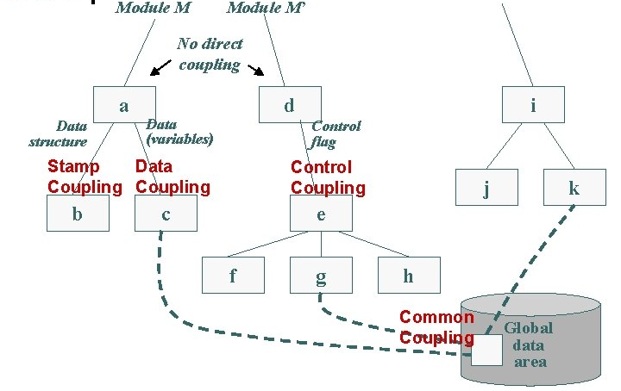
Coupling Examples
James Nowotarski, SE 325425: Principles and Practices of Software Engineering

Slide 36
Questions
Is functional cohesion always good?
There might be some occasions in which we have to choose another type of cohesion instead of functional cohesion.
In what case and why?
Is data coupling always good?
There might be some occasions in which we have to use common coupling, i.e., global variables.
In what case and why?
Adopted from Prof. Doo-Hwan Bae’s CS350 lecture material

Slide 37
Questions?

